Slide 1
FINAL PROJECT- Machine Learning model for inventory optimization
Alberto Quiroz
Ricardo Donoso
Juan Pedro Martínez
Emilio Segura

Slide 2
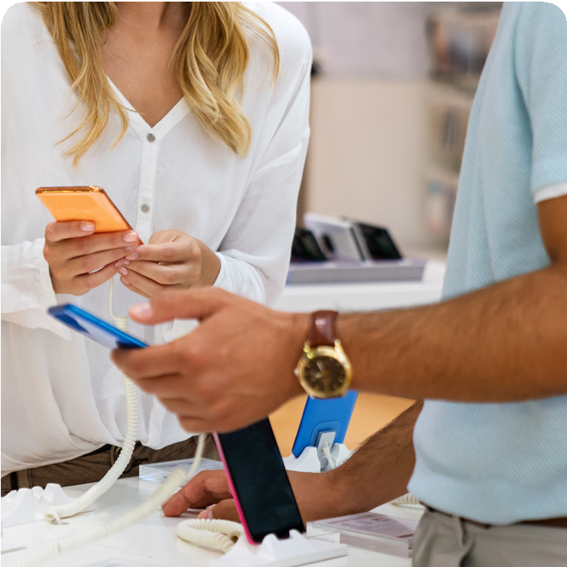





Mision
Satisfy the comunication needs of our clients giving them the best products and services.
Vision
Become a leading company in telecomunication and tech industry in El Bajio.
The company has 30 different stores in 3 different states in El Bajio (Queretaro, Guanajuato and Jalisco)
Company Background
Dimovil is a Mexican company that commercializes electronic devices within the central and western regions of the country. With 30 branches, Dimovil is currently trying to find a way to optimize their turnover inventory on their cell phone devices as well as reduce obsolete inventory on low turnover per location.

Slide 3
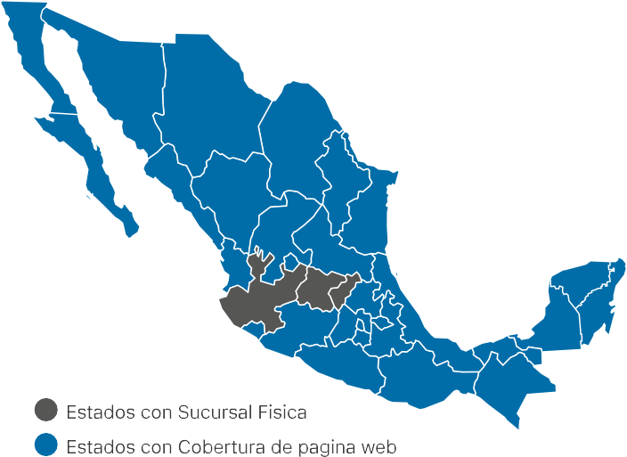
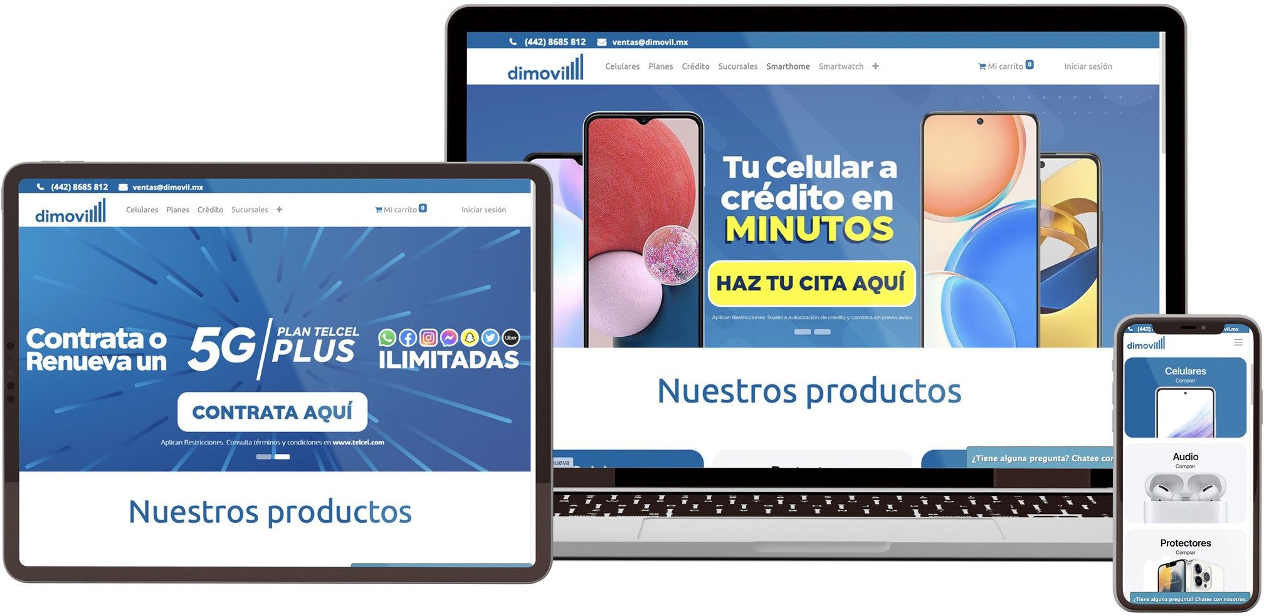
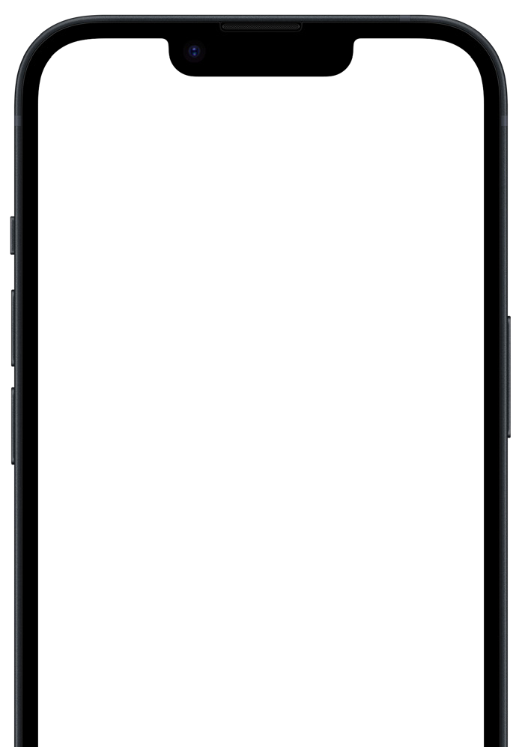
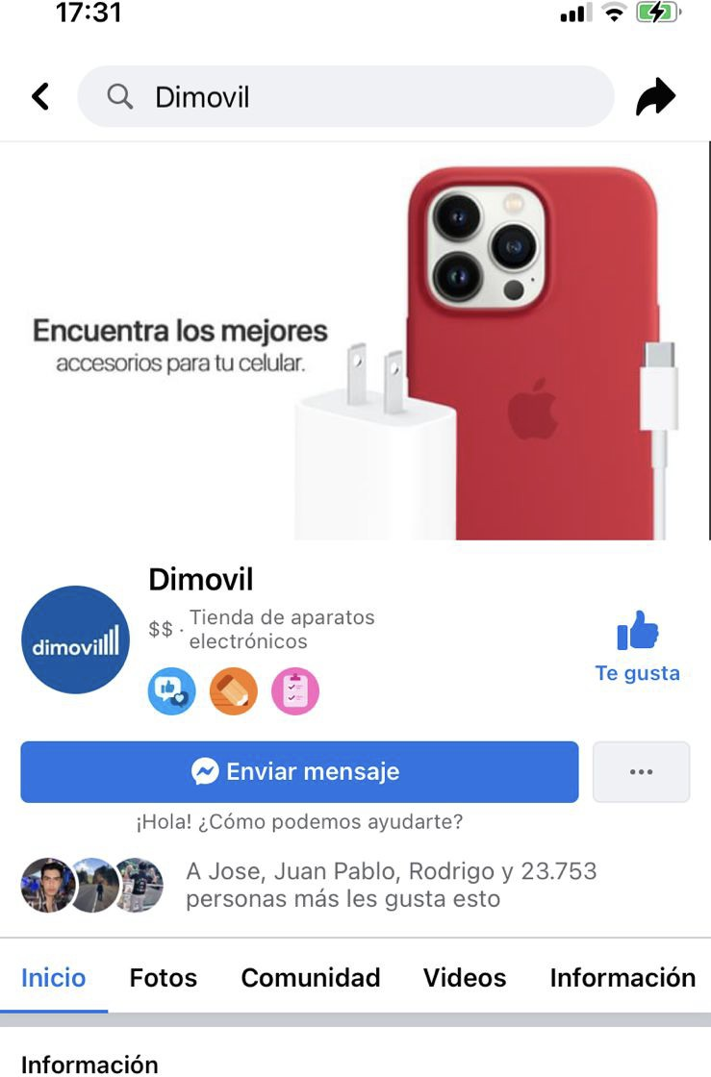
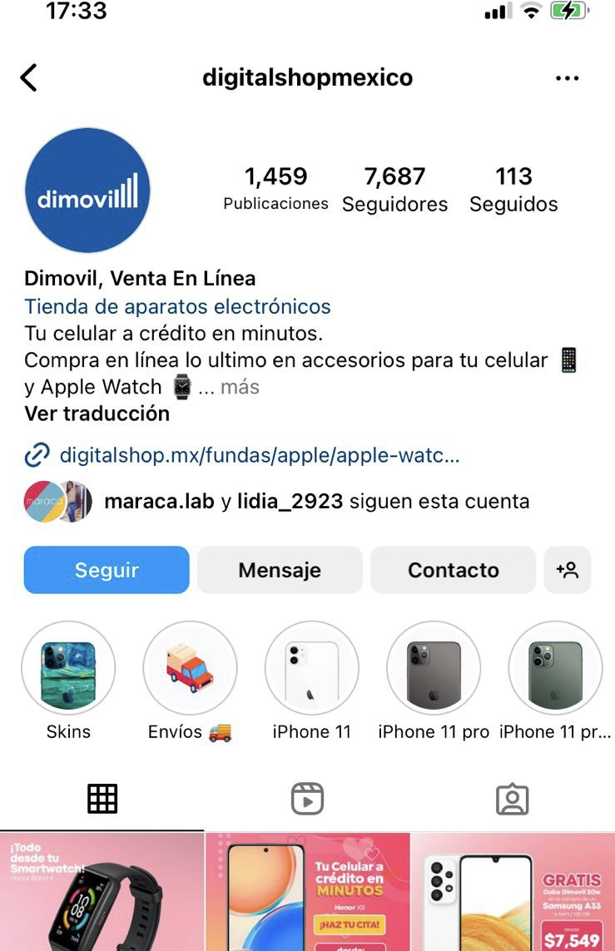
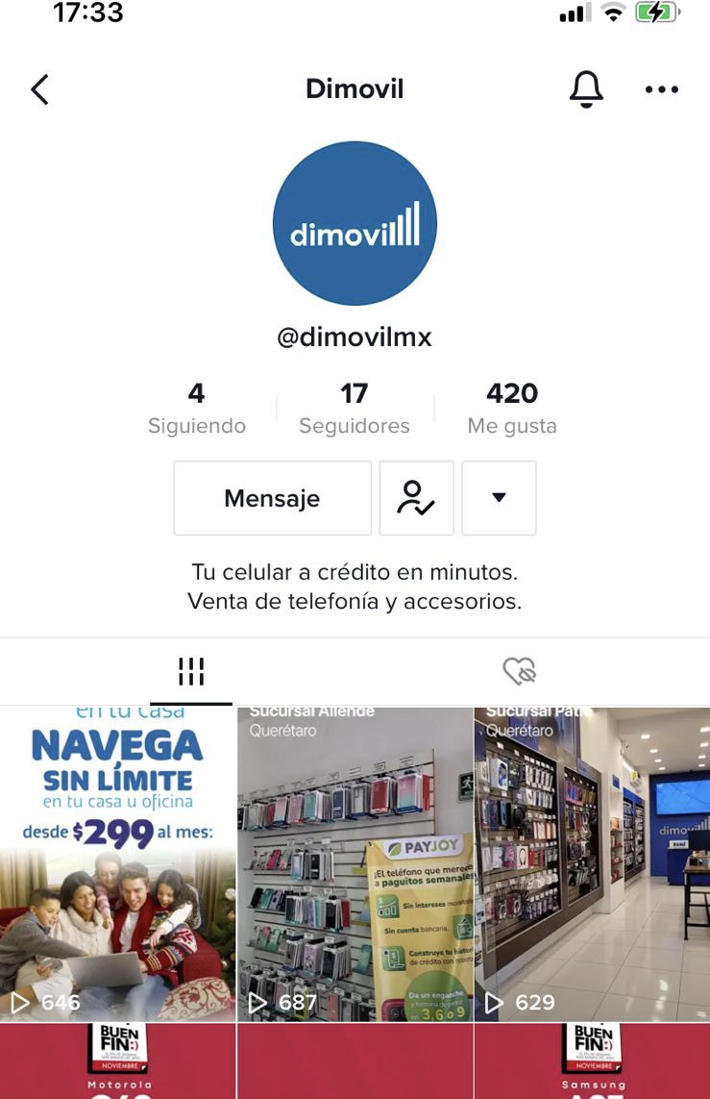

Slide 4
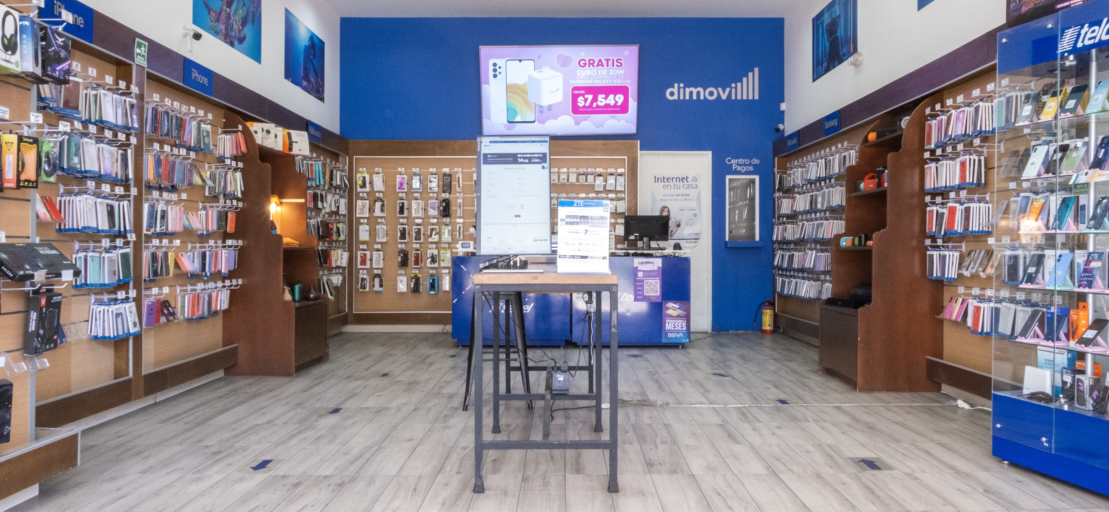
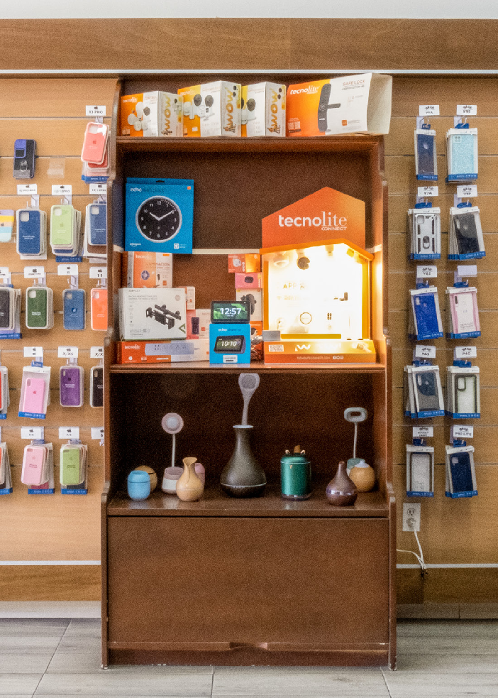
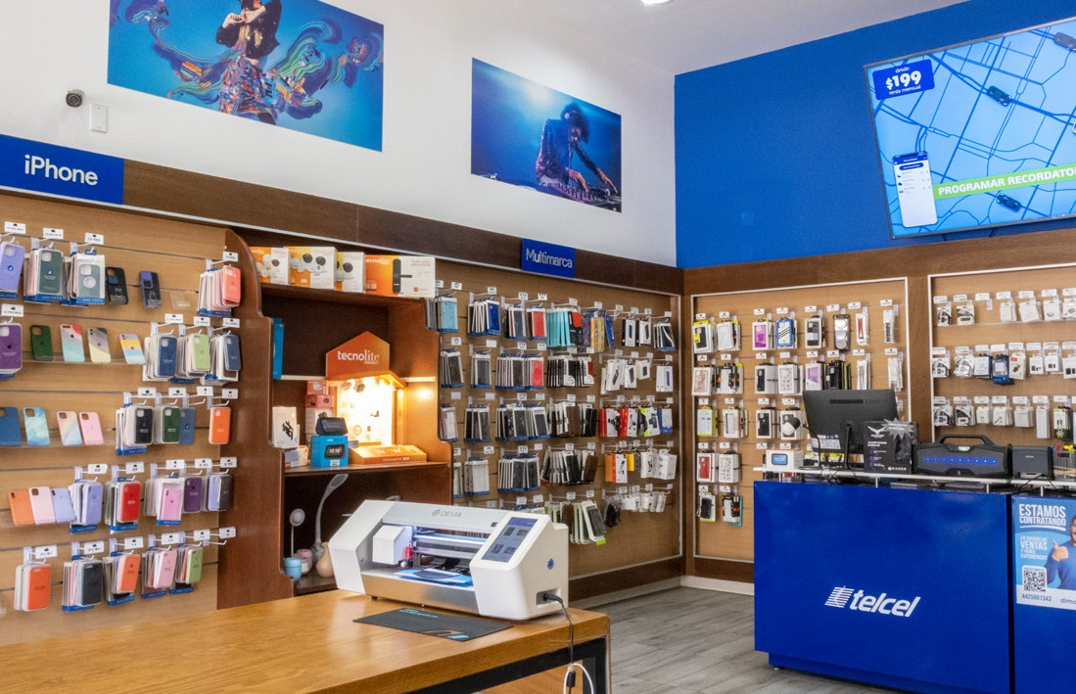
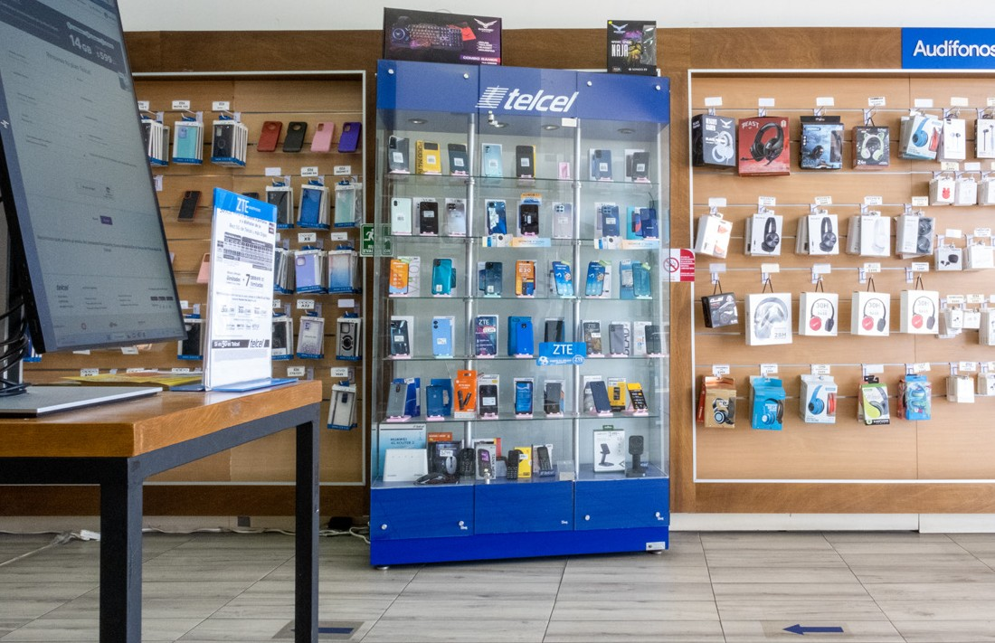

Slide 5
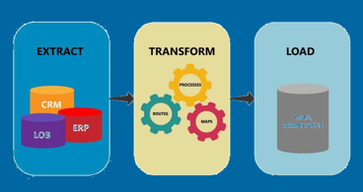
Project Overview
Using all the tools learned during the boot camp, such as, Python, Postgres, Tableau and machine learning, the aim of this project consists in developing a model that generates a demand prediction based on different variables like location, make, model and season.

